Slide 1
Machine Learning for Retinal Blood Vessel Segmentation
MA 797
Emily Zhang, Wanli Ma, Mitchel Colebank

Slide 2
Overview
Introduction: Biological motivation
Data
Machine Learning Architecture and Data Augmentation
Results
Conclusions and Future Work

Slide 3
Biological Motivation
Diabetes (elevated glucose levels) affects approximately 5.5% of the world population
Approximately 10% of these patients have diabetic retinopathy, a disease that can lead to blindness [1].
Considered one of the leading causes of blindness in the Western World.
The World Health Organization encourages early screening to help prevent disease worsening,
This motivates the need for more advanced, automated screening tools.

Slide 4
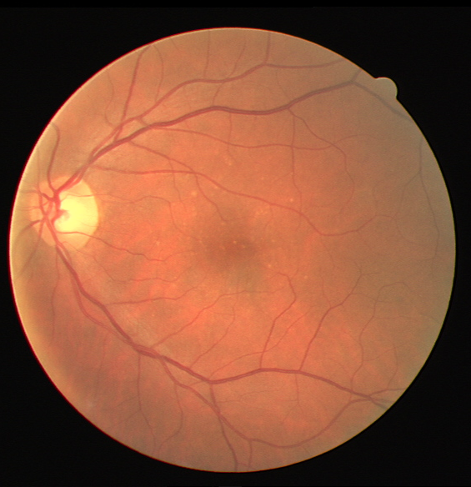
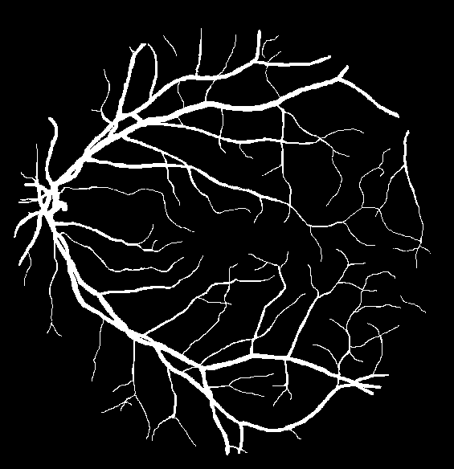
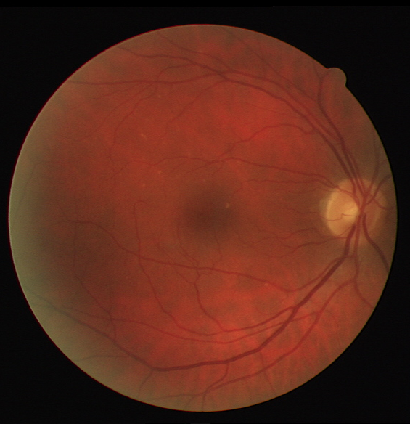
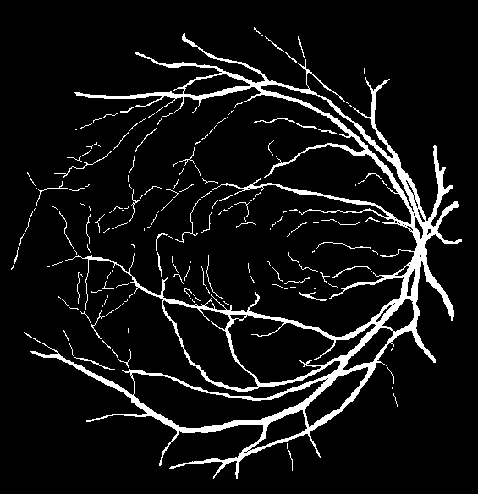
Retinal Imaging Data
Hundreds of blood vessels in an interconnected tree
Leads to 1 pixel wide ground truth with irregular shape
Small vessels are hardly visible in original image
≈
≈

Slide 5

Architecture: Original U-Net

Slide 6
Tasks
Need to increase the size of the data set
20 training images total leads to 0% accuracy
Could we train image segments?
Will the dimensions fit the U-Net?

Slide 7
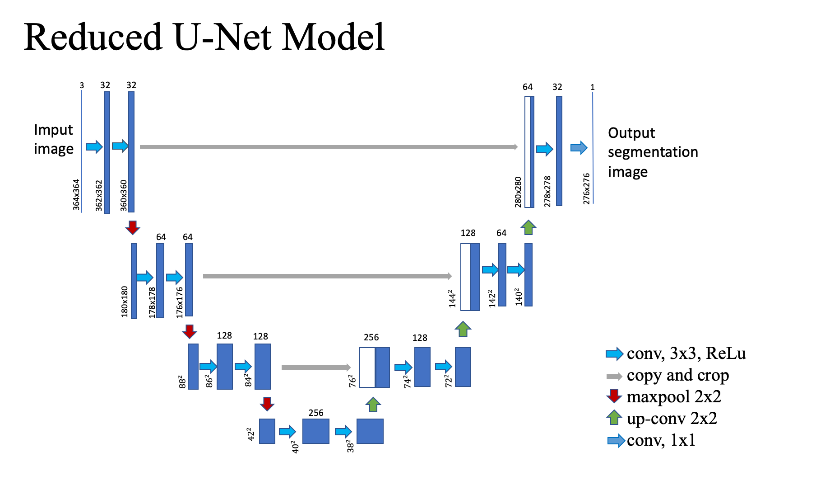

Slide 8
Options
•Standardization (using (max-data)/(max-min))
•Rotation
•Shearing
•Hue
•Shifted
•Centralized

Slide 9
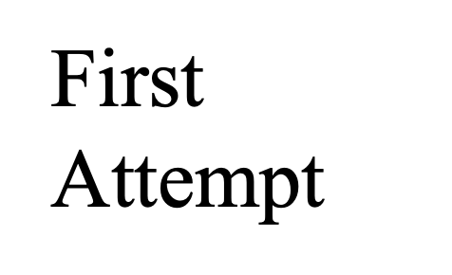
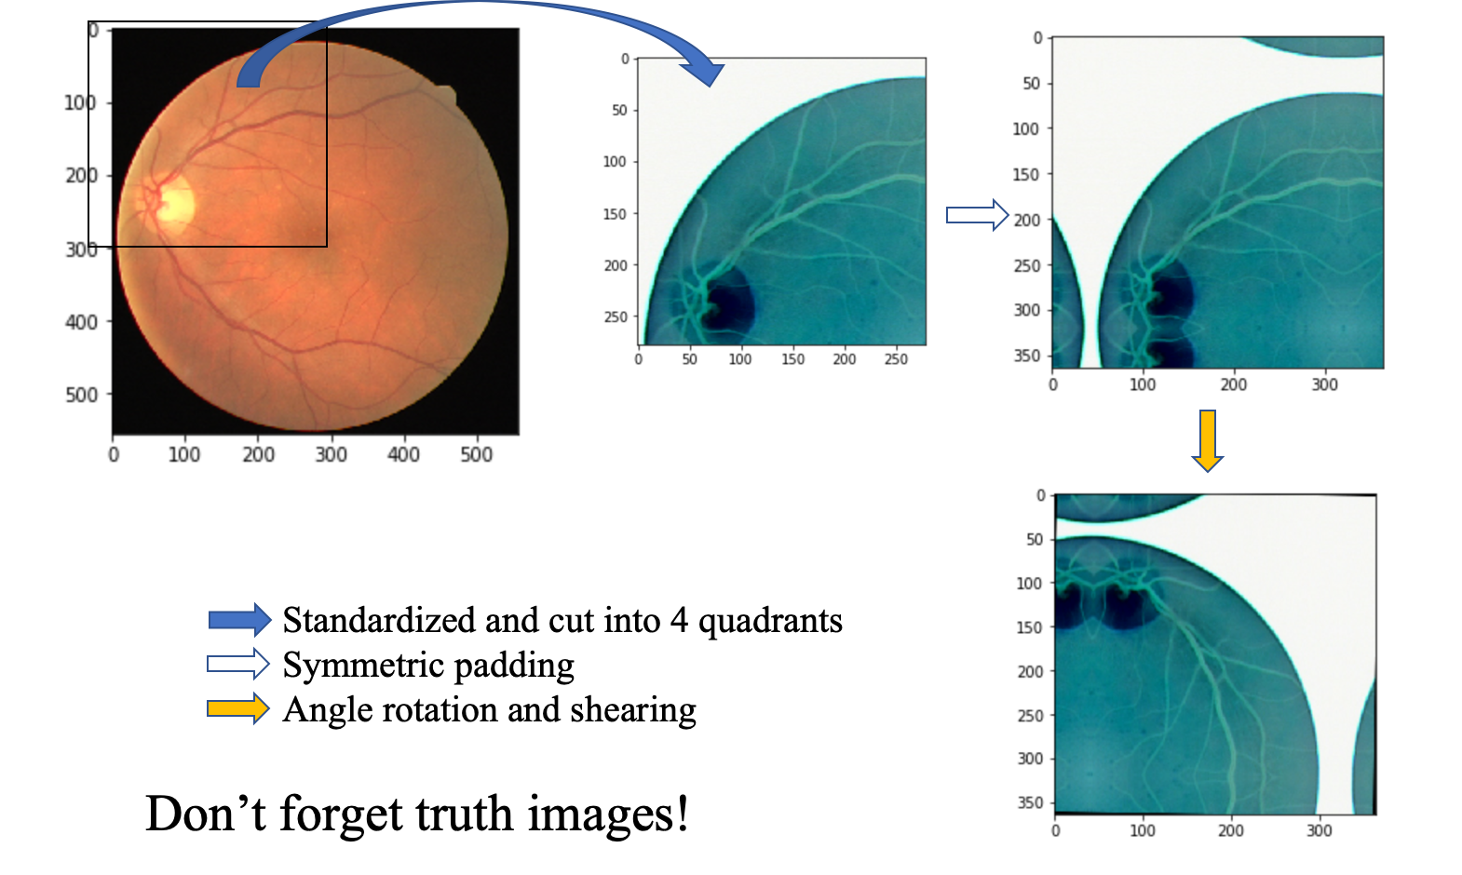

Slide 10
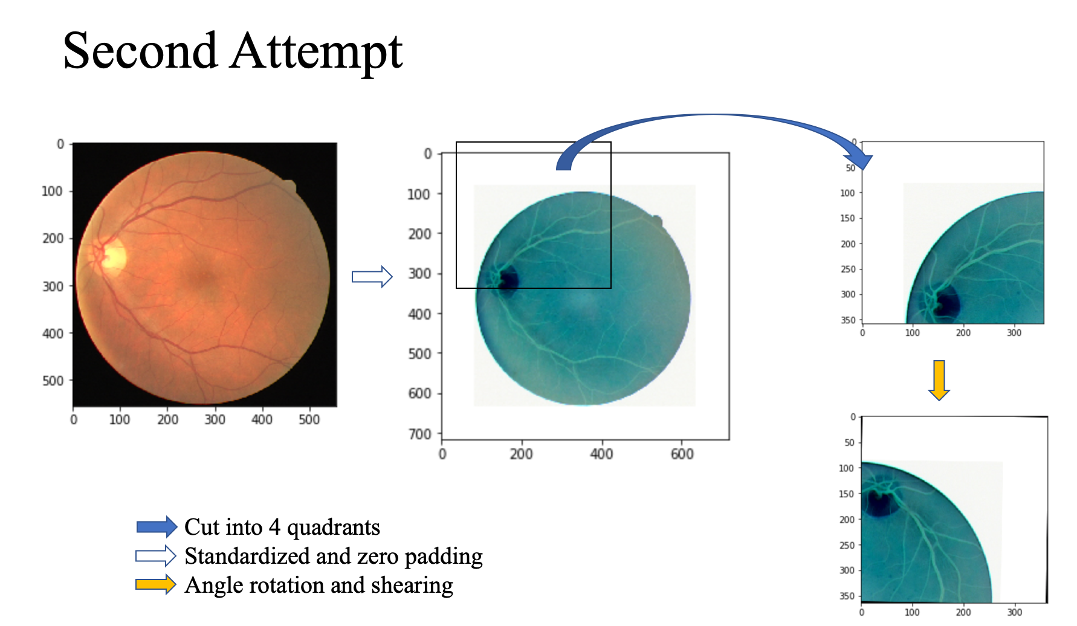

Slide 11
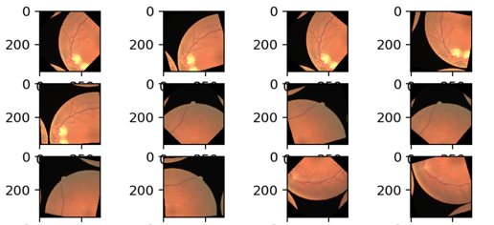
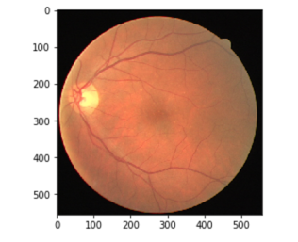
Issue: Lack of spatial context?

Slide 12
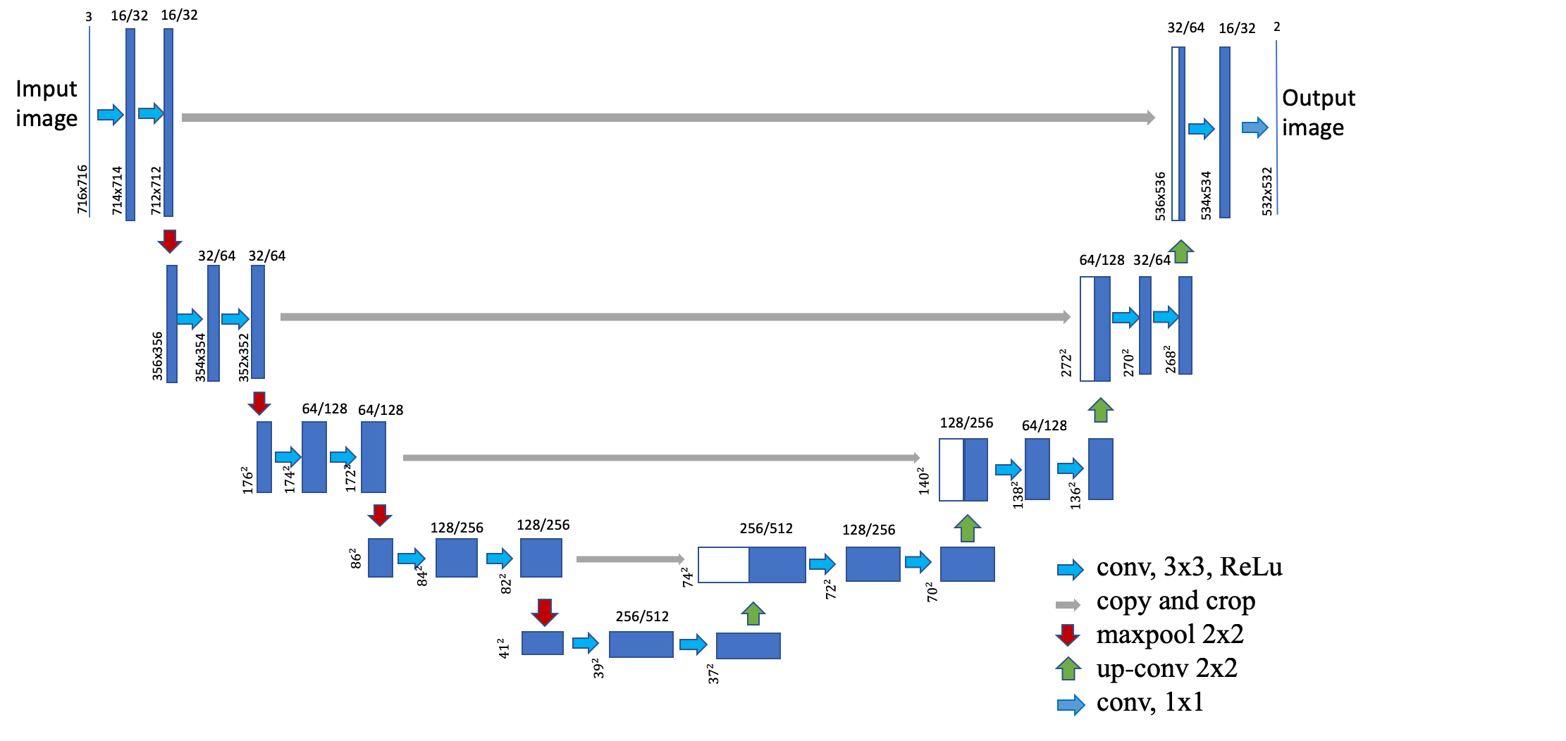
Update U-net Model

Slide 13
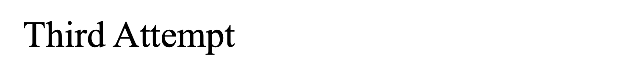
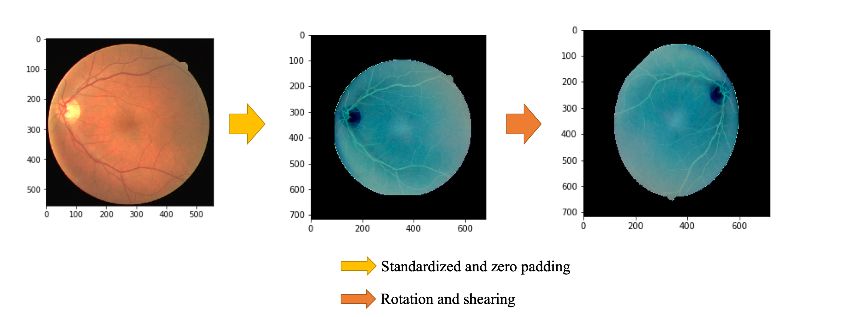

Slide 14
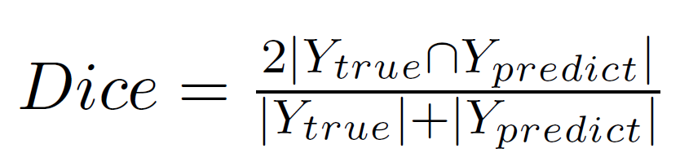
Results
Attempted to run the full, 1/2 , and 1/4 U-net models
(This is with respect to the number of 2D convs at each phase of the architecture)
Loss function: Pixelwise Crossentropy with
Weights foreground more than background (i.e. class 1 vs class 0)
Metrics: accuracy, and Dice Coefficient

Slide 15
Results
def dice_coef(y_true, y_pred):
y_true_f = K.flatten(y_true) ; y_pred_f = K.flatten(y_pred)
intersection = K.sum(y_true_f * y_pred_f)
return (2. * intersection) / (K.sum(y_true_f) + K.sum(y_pred_f))

Slide 16
Results
Image size (rgb format): 532*532*3
Truth size (black and white): 532*532*1
The output size must equal image size of the truth image
◦ after convolution, the output size is smaller than input size
◦ zero pad to make the image size bigger
Input size (rgb format): 716*716*3
Output size: 532*532*2

Slide 17
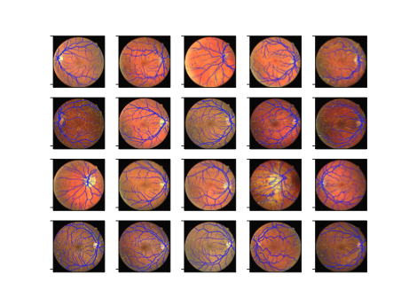
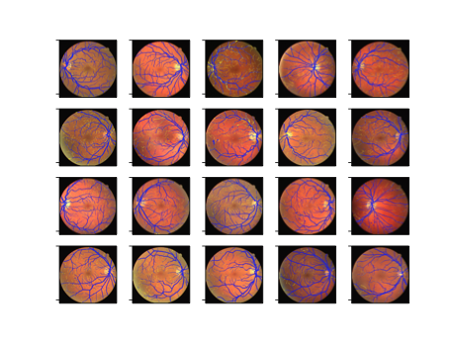
Results
Training Images
Testing Images

Slide 18
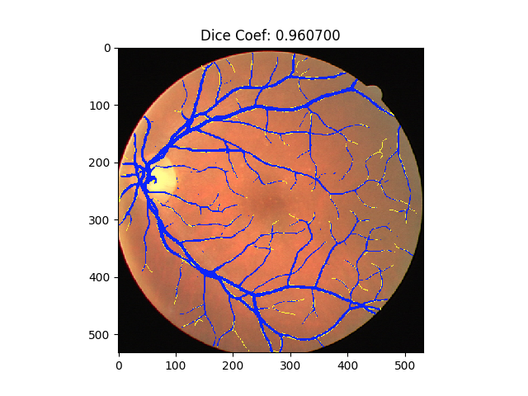
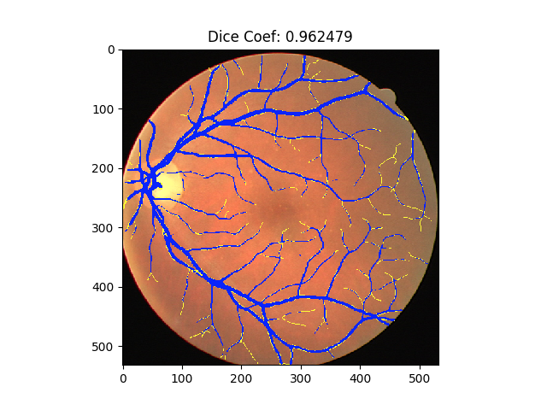
Yellow is ground truth, Blue is predicted
Test model 1 (32 filters, 49 epochs) Test model 2 (16 filters, 99 epochs)

Slide 19
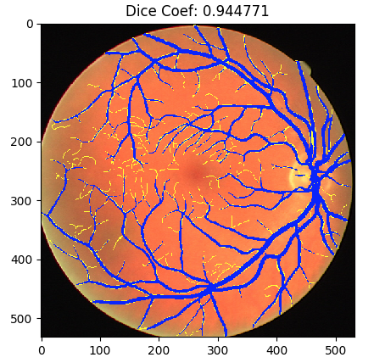
Small vessels are not captured in training (model 1)

Slide 20
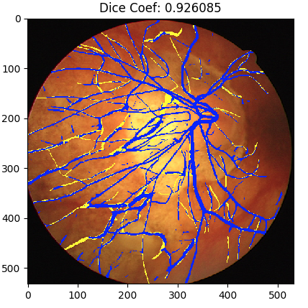
big vessels are not captured in training (model 1)

Slide 21
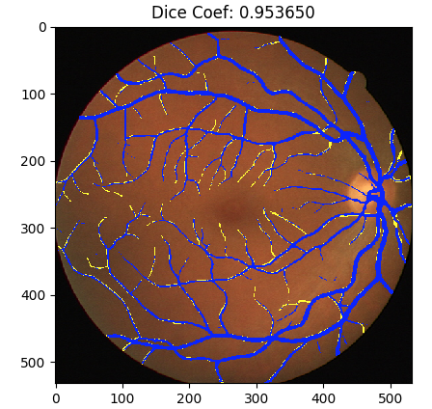
This looks fully trained (model 1)

Slide 22
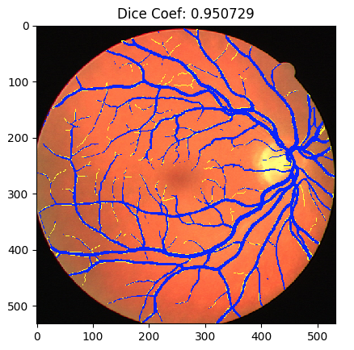
Test image (model 1) perfect!

Slide 23
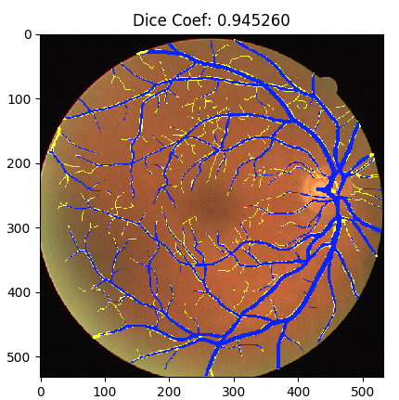
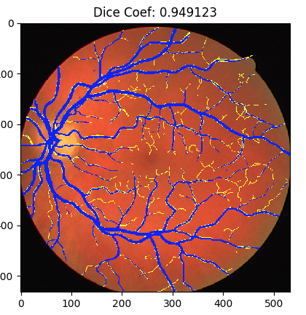
Test image (model 1) may not capture small vessels

Slide 24
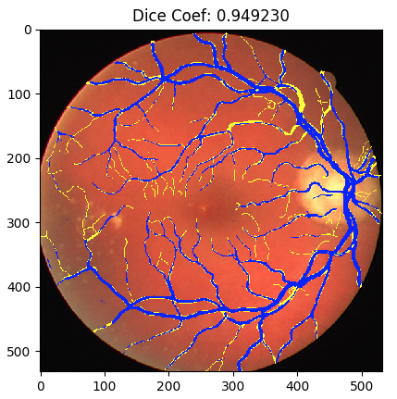
Test image (model 1) may not capture a big vessel

Slide 25
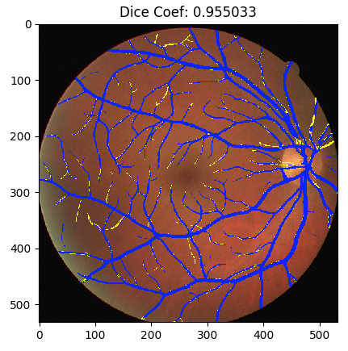
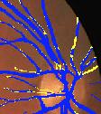
Results

Slide 26
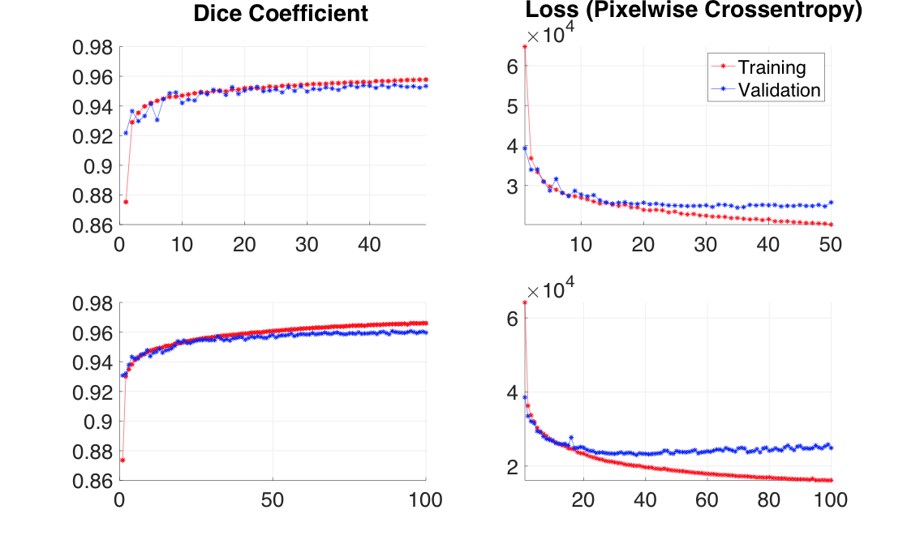
Results
Model 1
Model 2

Slide 27
Summary of Results:
The reduced 1/4 model was more computationally feasible to train given computing resources
Free availability of GPU’s may have allowed for better results in the full model
Seems that certain vessels are still uncaptured
May be due to reduced U-net architecture
Using full images as tile provide better result than reduced tiling

Slide 28
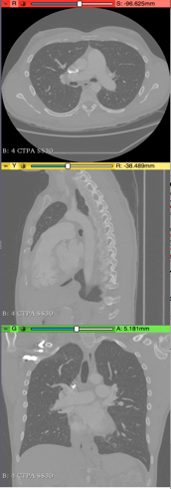
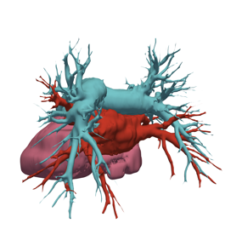
Future Directions:
3D U-net Architecture: Çiçek et. al, [3]
Can we somehow use the same architecture and data augmentation methods to classify human CT images?

Slide 29
References
J.J. Staal, M.D. Abramoff, M. Niemeijer, M.A. Viergever, B. van Ginneken, "Ridge based vessel segmentation in color images of the retina", IEEE Transactions on Medical Imaging, 2004, vol. 23, pp. 501-509.
Ronneberger, Olaf, et al. U-Net: Convolutional Networks for Biomedical Image Segmentation. 2015, pp. 1–8, doi:10.1007/978-3-319-24574-4_28.
Çiçek, Özgün, et al. “3D U-Net: Learning Dense Volumetric Segmentation from Sparse Annotation.” Lecture Notes in Computer Science (Including Subseries Lecture Notes in Artificial Intelligence and Lecture Notes in Bioinformatics), vol. 9901 LNCS, 2016, pp. 424–32, doi:10.1007/978-3-319-46723-8_49.

